Slide 1

Evolutionary prisoner’s dilemma game on a square lattice
MSDM5003 Final Project
GROUP 8 : ZHANG MINGTAO, LU HAOYANG
Time：2023.12.19

Slide 2
CONTENTS
01
02
03
04
Introduction
Model
Goal&Result
Conclusion

Slide 3
PART 01
Introduction
The introduction of the The Evolutionary Prisoner's Dilemma Game

Slide 4

Introduction
The Evolutionary Prisoner's Dilemma Game
The Evolutionary Prisoner's Dilemma Game is a classic game used to study the conflict between cooperation and competition.
Participants in the game is faced with the decision to cooperate or to defect. The prisoner's strategy can be passed on to future, making the evolution of the strategy possible.
After each round, the prisoners' strategies are evaluated and chosen based on the results of their interactions. The More successful strategy will have a higher chance of survival.

Slide 5
PART 02
Model
The rules and strategies we used to bulid the model of the game

Slide 6
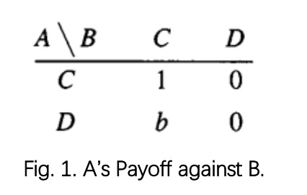
Model
The Evolutionary Prisoner's Dilemma Game
The players located on a square lattice can follow only two simple strategies: C (cooperate) and D(defect). Assuming the players get rewards R/P if both choose to cooperate/defect.
In the remaining two cases the defector’s and cooperator’s payoff are T(temptation to defect) and S(sucker’s payoff), respectively. We limited that T>R>P>S, and 2R>T+S.
To simplify we choose R=1, P=S=0, and T=b, where b >1. Thus the payoff to player A against B is given by the matrix in Fig. 1.

Slide 7
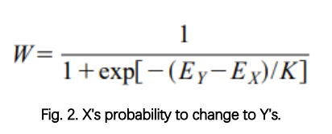
Model
The Evolutionary Prisoner's Dilemma Game
We consider two systems. In the first system, we only consider the influence of the four neighbors(above, below, left, and right), and in the second system, we consider the influence of the eight surrounding neighbors.
The randomly chosen player X revises its strategy according to the following rules: This player selects one of its neighbors Y with equal probability. Given the total payoffs(EX and EY) from the previous round, player X adopts the neighbor’s strategy with the probability W in Fig. 2., and K characterizes the noise introduced to permit irrational choices, the smaller K is, the more likely X is to choose Y’s strategy.(0<K<1)

Slide 8
PART 03
Goal&Result
What we want to obtain from the simulations and what results we actually get

Slide 9
Goal
The Evolutionary Prisoner's Dilemma Game
For both systems, the uniform cooperation (all C) is a stable state if b does not exceed a threshold value b_c1 that is larger than 1. This means that any constellation of defectors will be defeated if b<b_c1. In the same way the all Dstate remains stable for b>b_c2.
Henceforth we will concentrate on thosestates where the cooperators and defectors can coexist (b_c1 < b < b_c2). When coexisting, under the condition of initial random allocation of strategies, after more than ten rounds of strategy evolution, the overall density of collaborators in the L×L grid tends to be stable, which we mark as c. We use the Fig. 1. A’s Payoff against B. Fig. 2. X’s probability to change to Y’s. field mean approximation theory, use c to represent an individual's final choice trend in this model, and explore the relationship between c and b.

Slide 10
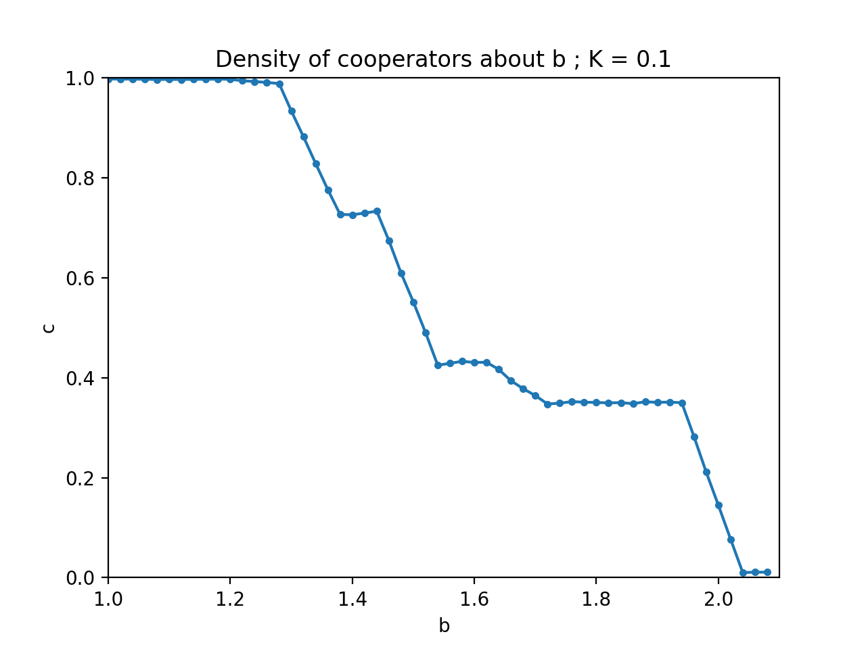
model1: 4 neighbours, L=100, K=0.1
The Evolutionary Prisoner's Dilemma Game
First we consider the model with 4 neighbours’ interactions. Fig. 3. shows the c-brelationship in the coexistence region for K=0.1, c decreases with increasing b until the second threshold b_c2 , where the cooperators vanish. The sharp steps appear at the break points like b=4/3, 3/2.
Fig. 3. Density of cooperators as a function of temptation to defect for 4 neighbours, L=100, K=0.1.

Slide 11
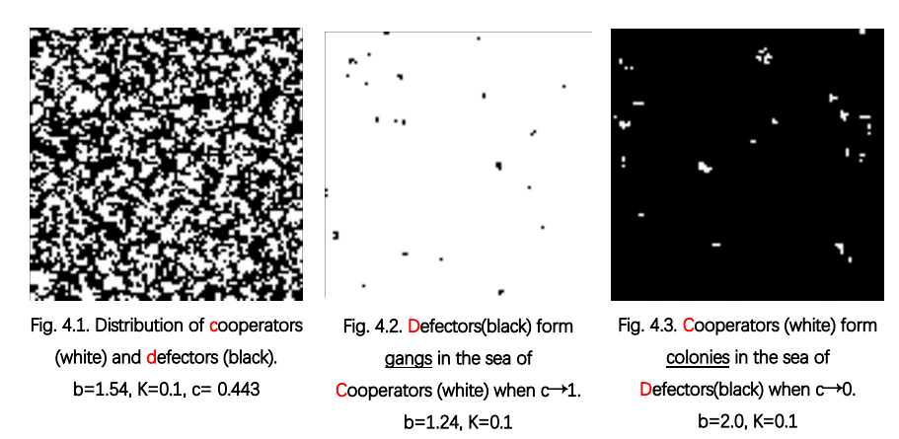
model1: 4 neighbours, L=100, K=0.1
The Evolutionary Prisoner's Dilemma Game
We can use simulated data to fit the c-b curve, but first we must ignore the situations when c tends to 0 or 1. Because the premise of mean-field approximate field theory is overall uniformity, but when c tends to 1 or 0, the distribution of defectors or cooperators is clustered.
The mean-field approximations are not able to handle with the long-range correlations. These gangs or colonies will walk randomly, suddenly appear or disappear as the simulation proceeds. In these c→ 0/1 cases, our simulation curve cannot really predict an individual’s strategic expectations. Examples can be seen in Fig. 4.2 and Fig. 4.3.

Slide 12
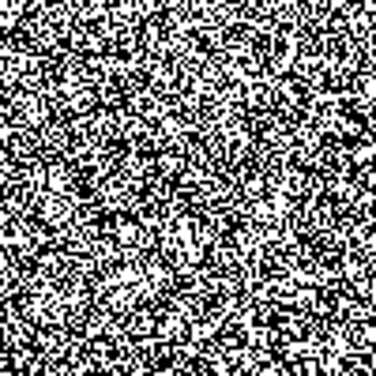
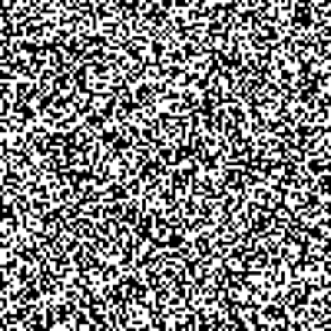
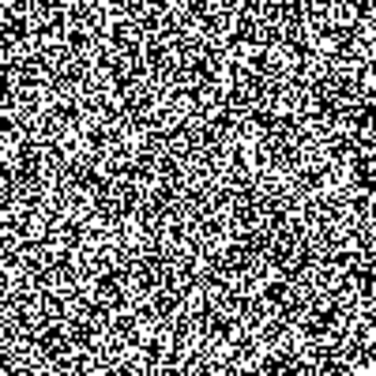
model1: 4 neighbours, L=100, K=0.1
The Evolutionary Prisoner's Dilemma Game
Fig. 4.1. Distribution of cooperators (white) and defectors (black). b=1.54, K=0.1, c= 0.443
Fig. 4.2. Defectors(black) form gangs in the sea of Cooperators (white) when c→1. b=1.24, K=0.1
Fig. 4.3. Cooperators (white) form colonies in the sea of Defectors(black) when c→0. b=2.0, K=0.1

Slide 13
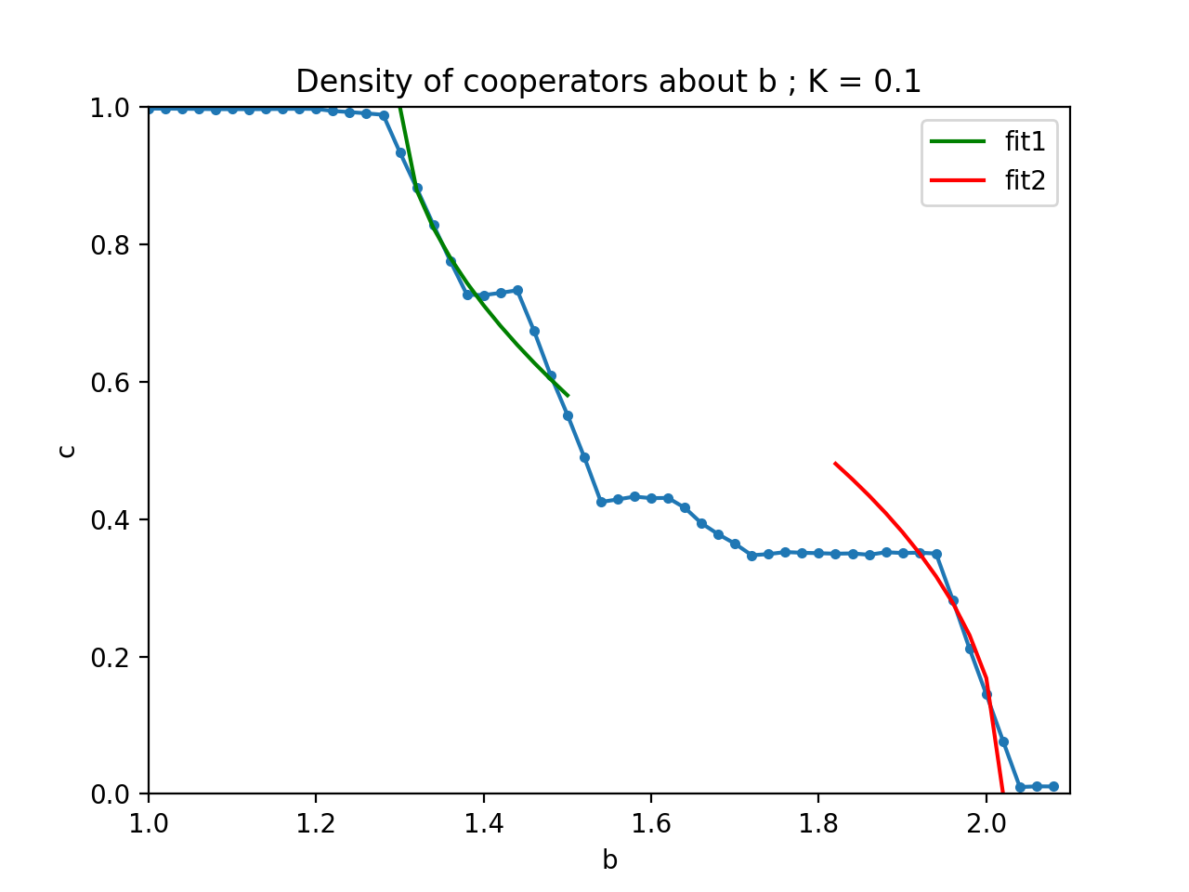
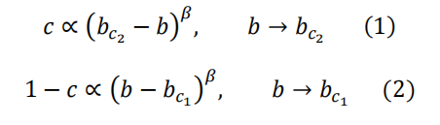
model1: 4 neighbours, L=100, K=0.1
The Evolutionary Prisoner's Dilemma Game
Our MC data shown in Fig. 3 refer to a power-law behavior:
The best fit for equation (1) is obtained for b_c2=2.02 and β=0.455;
The best fit for equation (2) is obtained for b_c1=1.30 and β=0.539. As Fig. 5. shows.
Fig. 5. Fit curve about the c-b data for 4 neighbours, L=100, K=0.1.

Slide 14
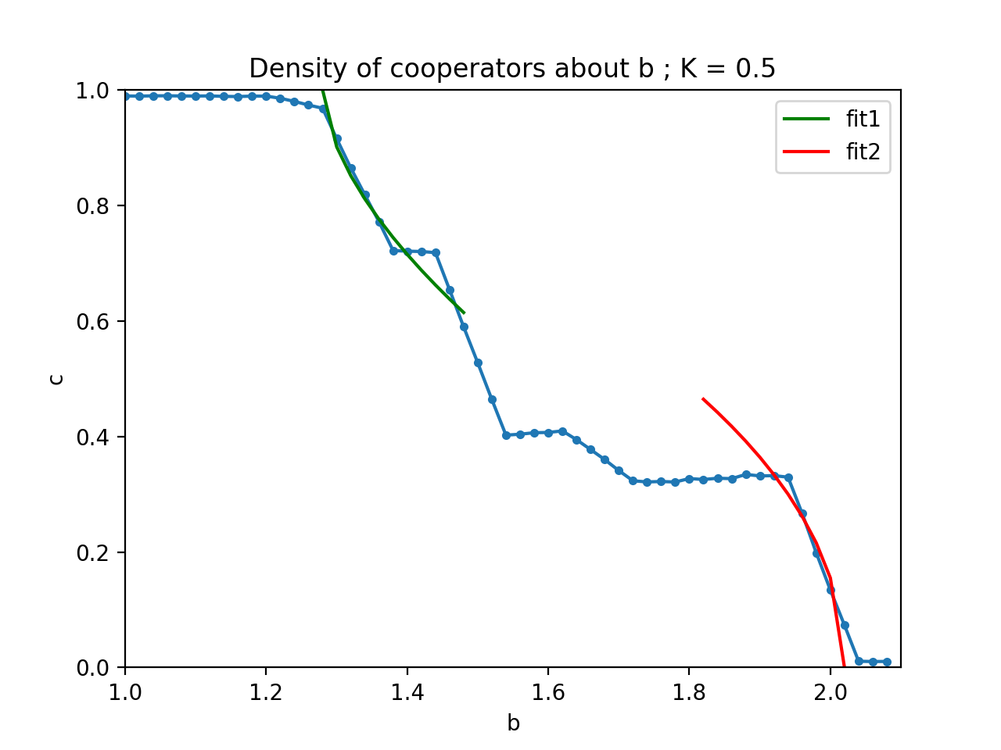
model2: 4 neighbours, L=100, K=0.5
The Evolutionary Prisoner's Dilemma Game
The best fit for equation (1) is obtained for b_c2=2.02 and β=0.476;
The best fit for equation (2) is obtained for b_c1=1.28 and β=0.592.
Fig.6. Fit curve about the c-b data for 4 neighbours, L=100, K=0.5.

Slide 15
Comparison between model1 and model2
The Evolutionary Prisoner's Dilemma Game
From the comparison between the model1(K=0.1) and model2(K=0.5), We can find that when the K is larger, the power law curve fit2 fits the c-b function almost the same, while the curve fit2 fits the c-b function better.

Slide 16
Comparison between model1 and model2
The Evolutionary Prisoner's Dilemma Game
Comparison between model1 and model2 Distribution of cooperators (white) and defectors (black). b=1.24, K=0.1(left),K=0.5(right)
Comparison between model1 and model2 Distribution of cooperators (white) and defectors (black). b=2.0, K=0.1(left),K=0.5(right)

Slide 17
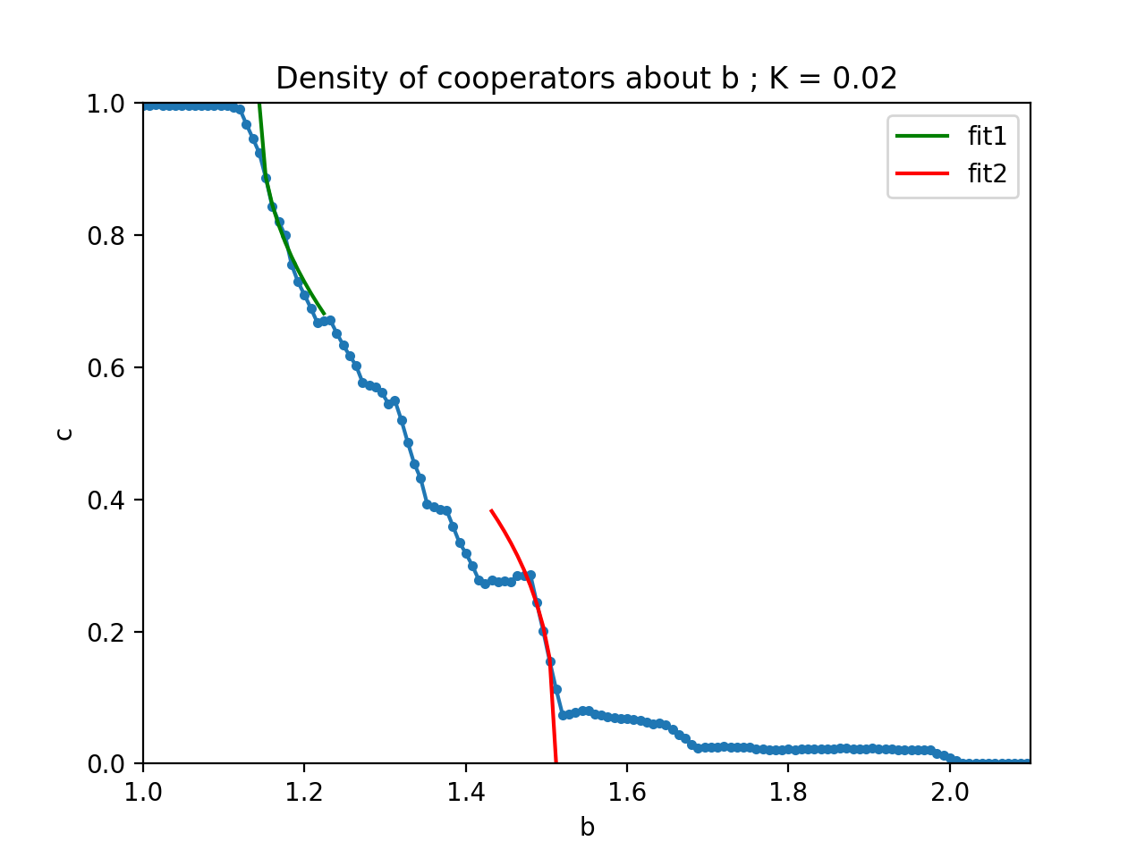
model3: 8 neighbours, L=100, K=0.02
The Evolutionary Prisoner's Dilemma Game
For the second system, we consider the surrounding 8 neighbours and get two c- b plots of K=0.02 and K=0.5 as Fig. 7. And Fig. 8. shows. Compared with the first system, the fault frequency of c is higher and the decline speed is faster.
For K=0.02:
The best fit for equation (1) is obtained for b_c2=1.512 and β=0.380;
The best fit for equation (2) is obtained for b_c1=1.144 and β=0.452.
Fig. 7. Fit curve about the c-b data for 8 neighbours, L=100, K=0.02

Slide 18
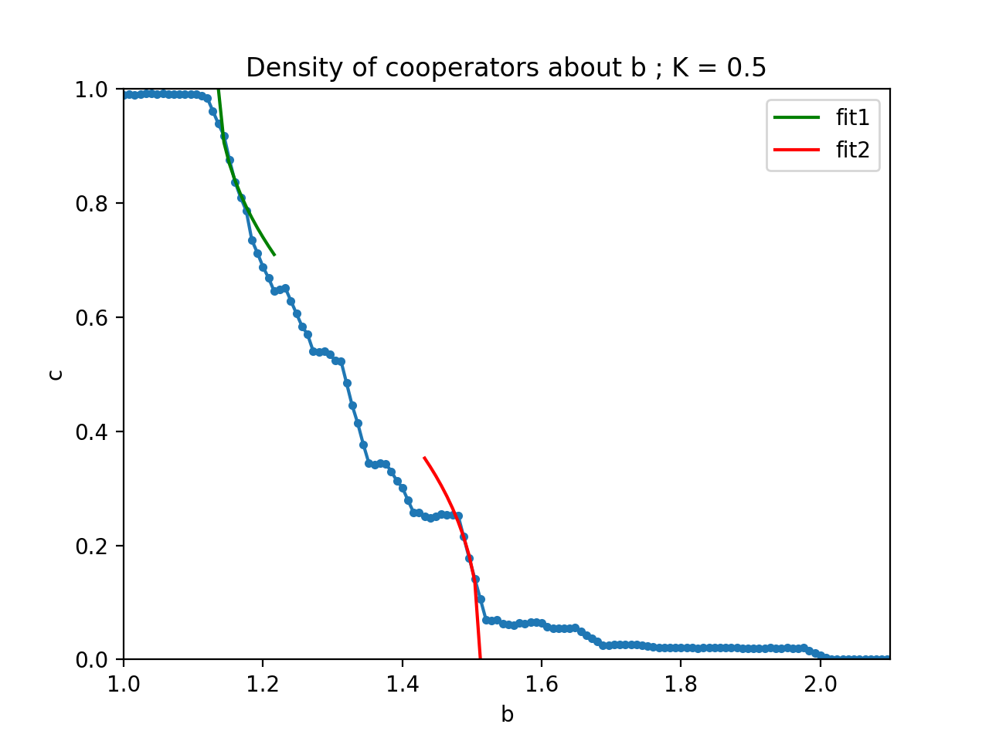
model4: 8 neighbours, L=100, K=0.5
The Evolutionary Prisoner's Dilemma Game
The best fit for equation (1) is obtained for b_c2=1.512 and β=0.412;
The best fit for equation (2) is obtained for b_c1=1.136 and β=0.489.
Fig. 8. Fit curve about the c-b data for 8 neighbours, L=100, K=0.5.

Slide 19
Comparison between model3 and model4
The Evolutionary Prisoner's Dilemma Game
From the comparison between the model3(K=0.02) and model4(K=0.5), We can find that when the K is larger, the curve fit1 and fit2 fit the c-b function better.

Slide 20
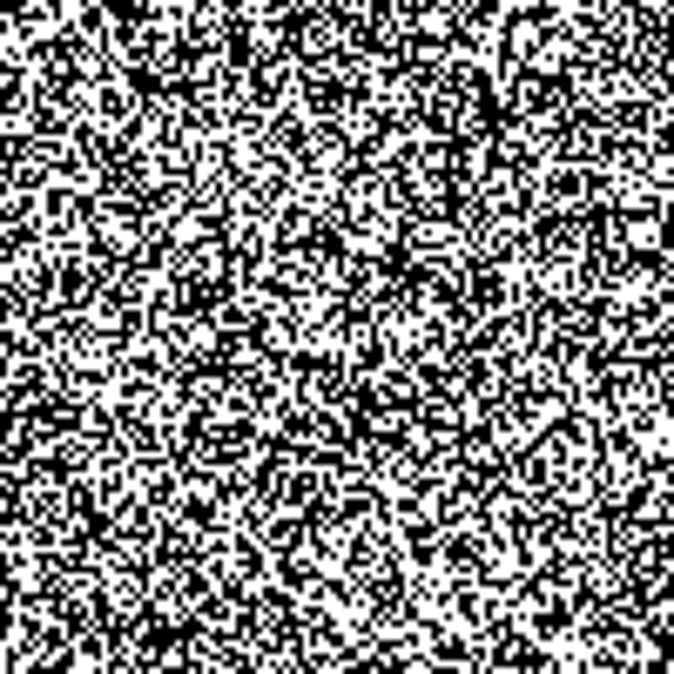
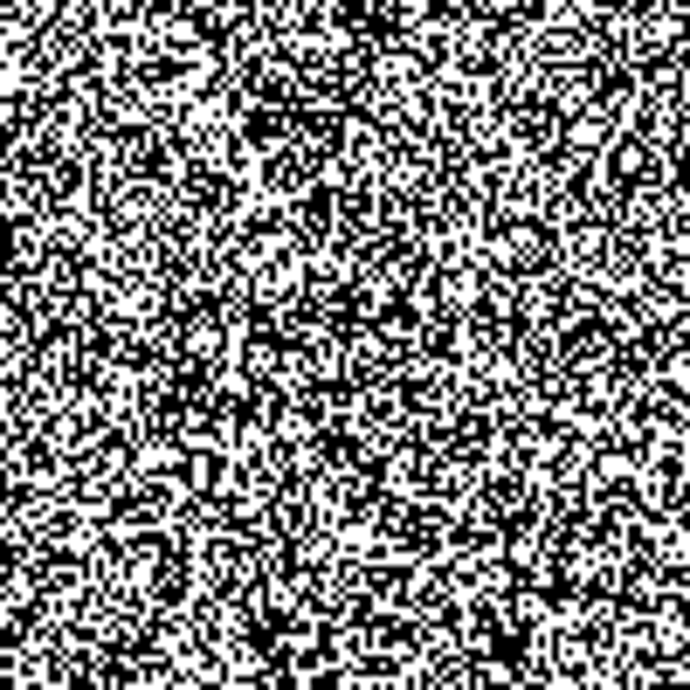
Comparison between model3 and model4
The Evolutionary Prisoner's Dilemma Game
Comparison between model3 and model4 Distribution of cooperators (white) and defectors (black). b=1.18, K=0.02(left),K=0.5(right)
Comparison between model3 and model4 Distribution of cooperators (white) and defectors (black). b=1.51, K=0.02(left),K=0.5(right)

Slide 21
PART 04
Conclusion
What we learn from the process of simulation and the general conclusion of our project

Slide 22
Conclusion
The Evolutionary Prisoner's Dilemma Game
When the defector rate b is too high or too low, the final result of the strategy evolution will be all cooperation or all deception. When both states can coexist, bis within a threshold range: b_c1-b_c2, and the values of both 2 thresholds decrease as the number of neighbors we considered increases. No matter which system, the relationship between the final collaborator density c and the cheating benefit b can be fitted and predicted through the power law formula:
When b goes close to the boundary value b_c1 or b_c2, which means the cooperator density of c goes close to 0 or 1, fitting curve will be more accurate. Besides, as the random disturbance K increases, this fitting curve will be more reasonable and accurate.

Slide 23
Thanks For Listening!
GROUP 8 : ZHANG MINGTAO, LU HAOYANG
Time：2023.12.19

